Slide 1
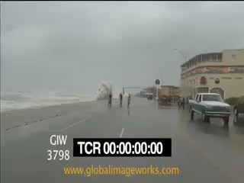
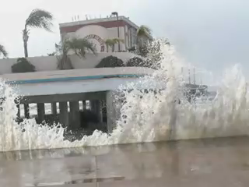
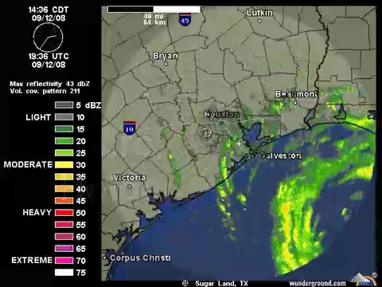
The Ike Dike
A Coastal Barrier
Protecting the Houston/Galveston Region from Hurricane
Storm Surge
A Coastal Barrier System
Protecting the Houston/Galveston Region from Hurricane Storm Surge

Slide 3
As Bad as Hurricane Ike Was
We Dodged a Bullet
If farther west,
many more lives lost,
much more damage

Slide 5
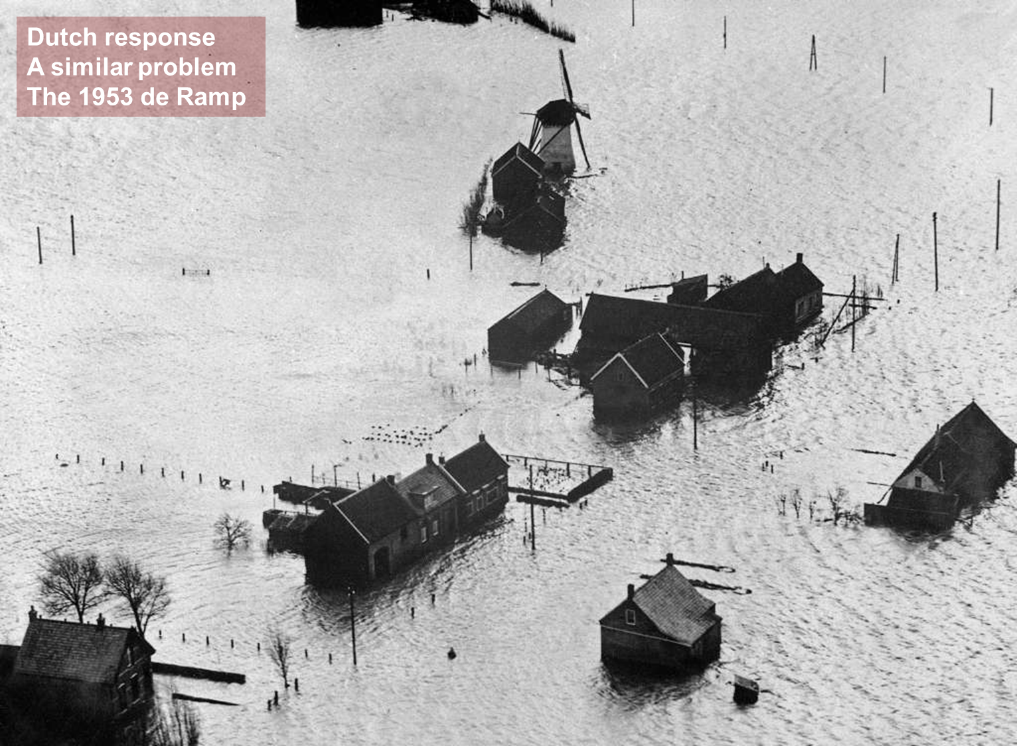

Slide 6
Dutch Delta Commission
Considered Two Major Options
    Continue building and strengthening internal dikes/barriers
    Shorten the surge defense needed with a coastal spine

Slide 7
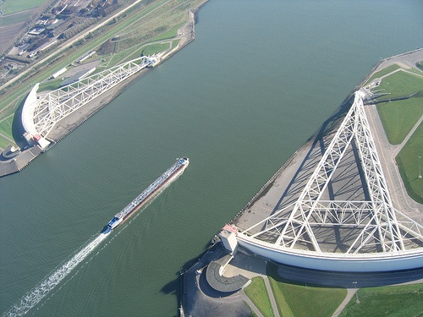
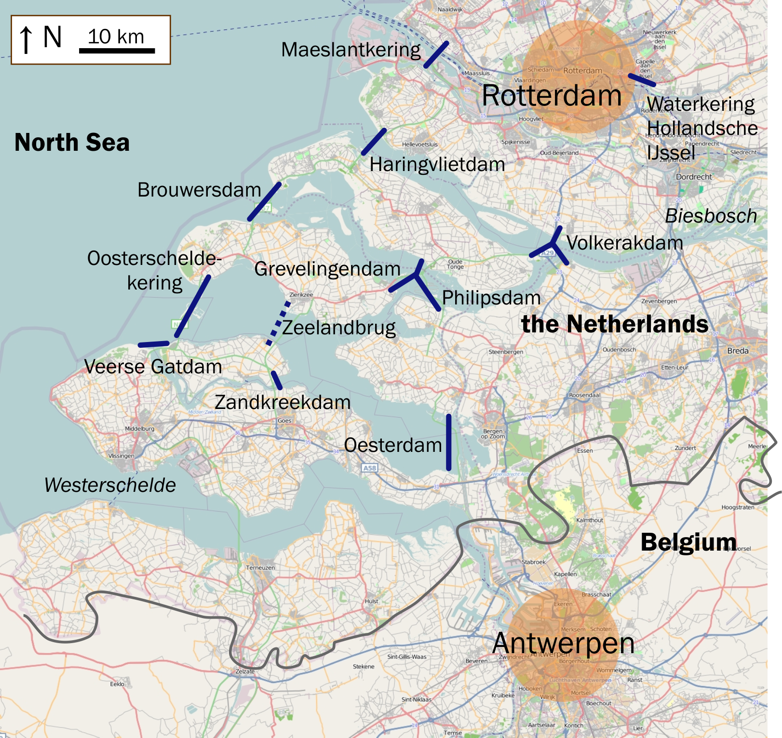
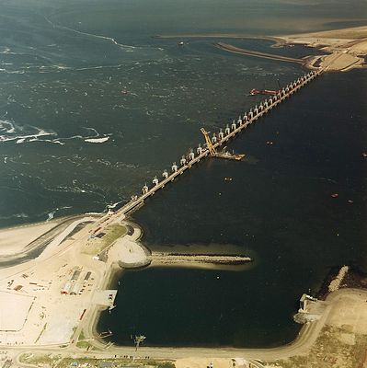
Notes:
Dutch Deltaworks – combines dams and flood gates (illustrated in slide) to form a coastal spine. Offers protection to numerous low-lying communities.

Slide 8

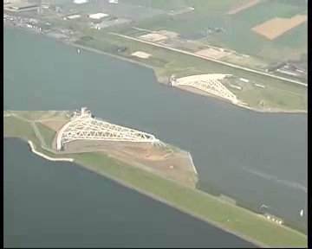

Slide 9
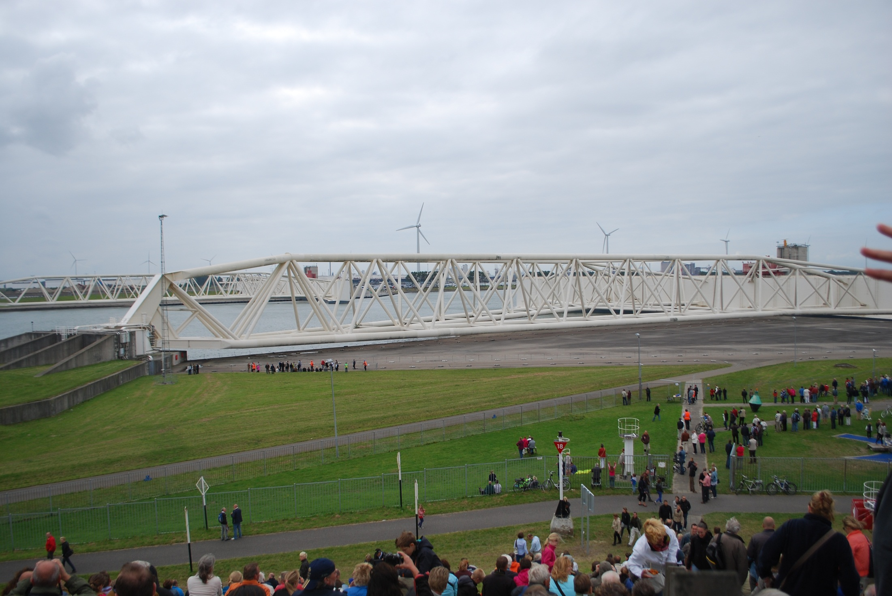
Start of Gate Closing – September 2012
Texas Delegation

Slide 10
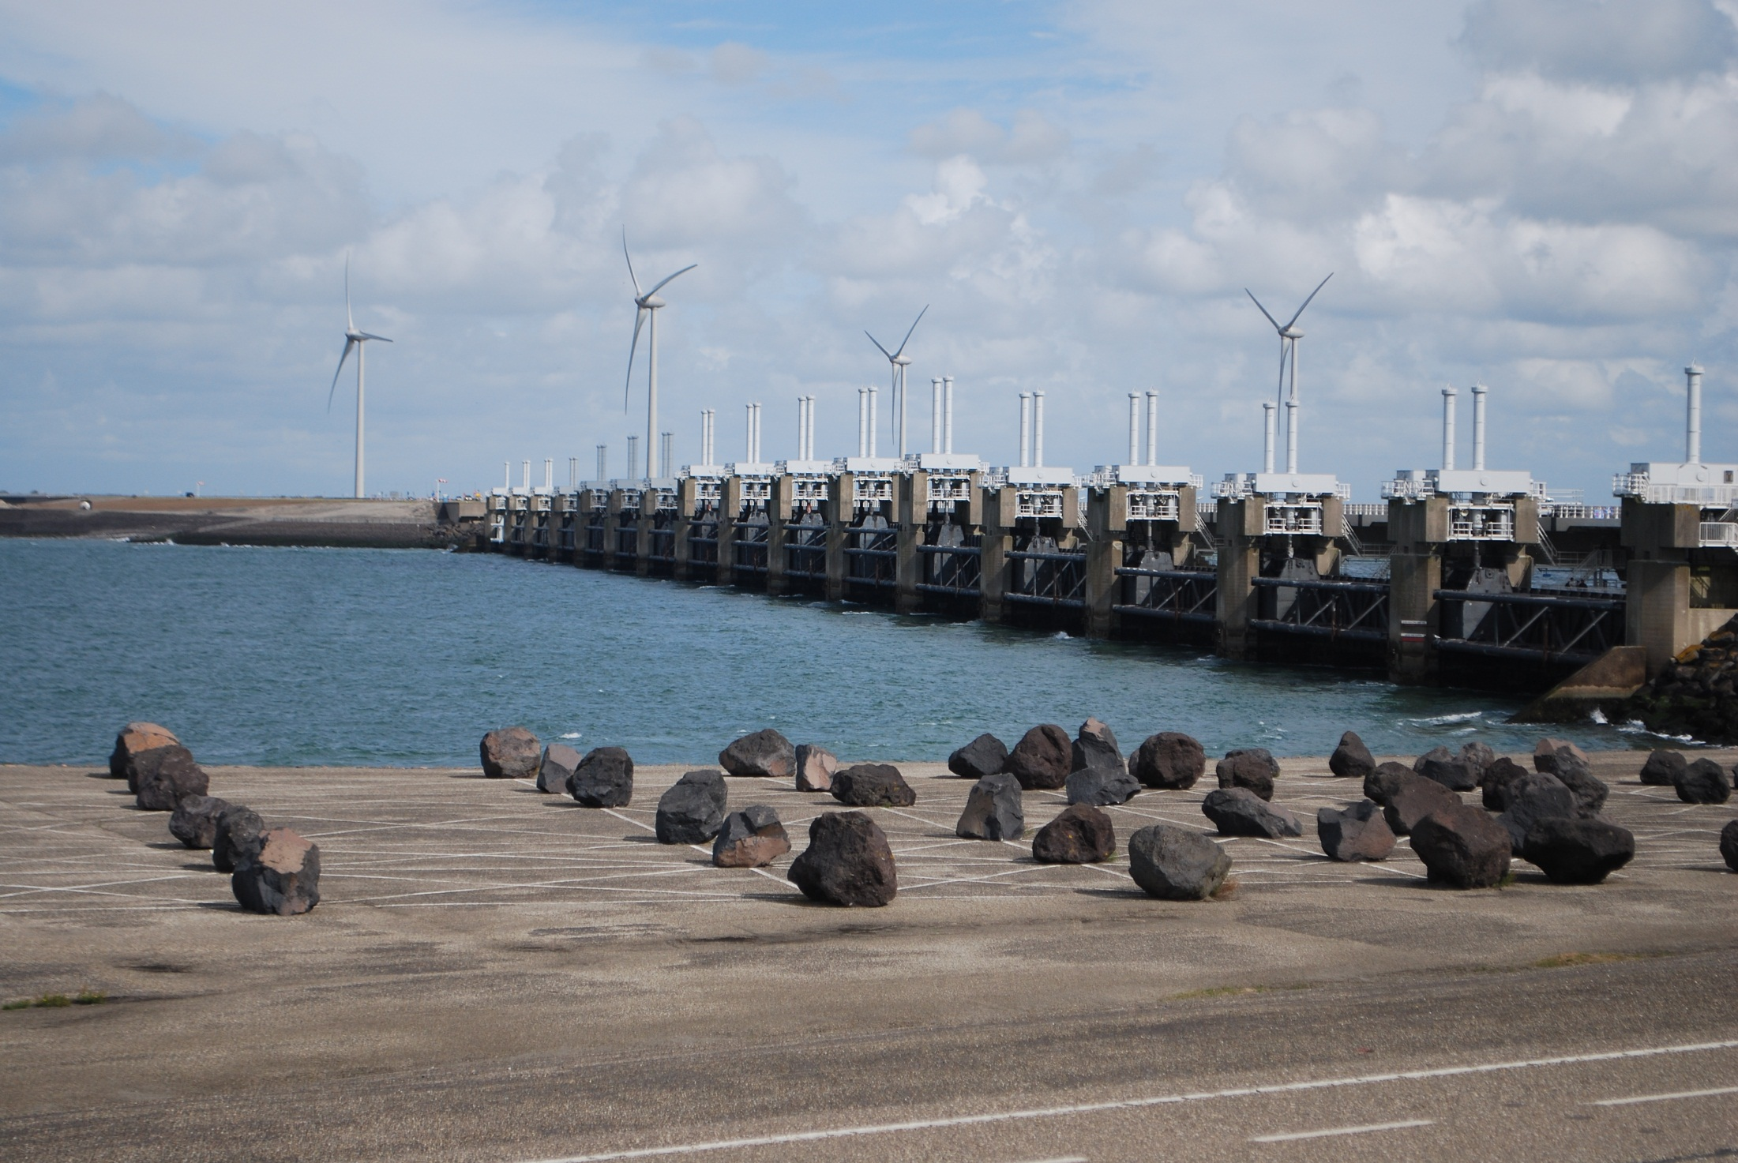

Slide 11
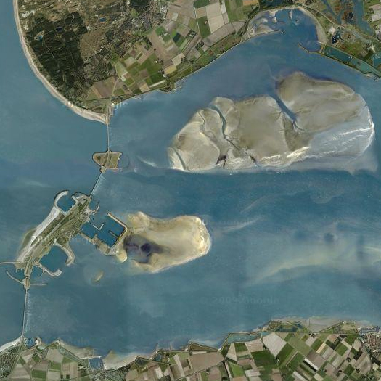
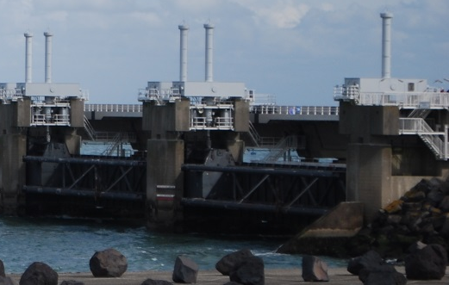
Eastern Scheldt Barrier
A giant engineering structure, The Eastern Scheldt storm surge barrier ('Oosterscheldekering'), was completed in 1986 and is part of the 'Deltaworks' started after the 1953 flood. The barrier has 62 steel doors each 140 feet wide. They are normally open but are closed when there is a North Sea high water level alert. The door gates slide between big concrete pillars, each one up to 130 feet high. The barrier consists of three parts between artificially created islands. When open, the gates allow water exchange between the North Sea and the estuary assuring a healthy bay.
North Sea

Slide 12
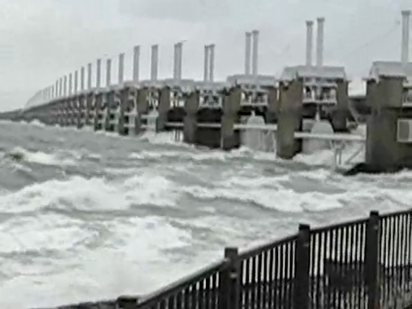
The Netherlands
Storm Surge Barrier in Action
Notes:
Following the Dutch lead, we can now design Gate systems that protect from surge but also provide needed circulation when open

Slide 13
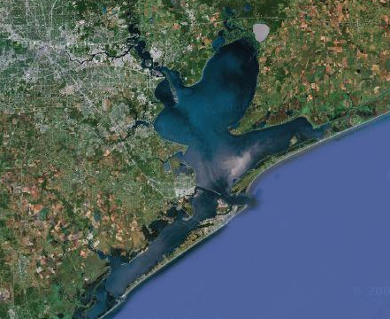
The Ike Dike strategy is to keep the ocean surge out of Galveston Bay by using a gated coastal barrier
Houston Ship Channel
High
Island
Bolivar Peninsula
Bolivar Roads
Galveston Island
Existing Seawall
Intracoastal Waterway
Coastal Spine
• San Luis Pass
Notes:
The critical need is to stop the surge at the coast – this protects the entire Bay area
1. Protects from catastrophic overflows and
2. Doesn’t allow the ocean surge into the Bay which in turn prevents massive internal surges

Slide 14
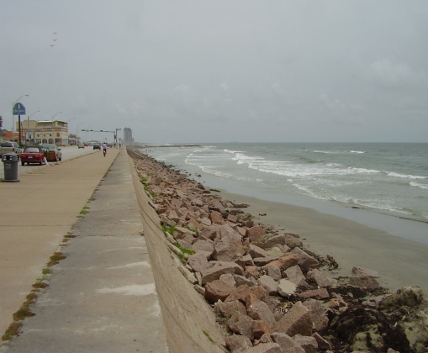
The first component of the Ike Dike already exists – the Galveston Seawall
Houston Ship Channel
High
Island
Bolivar Peninsula
Bolivar Roads
Galveston Island
Existing Seawall
Intracoastal Waterway
• San Luis Pass
Notes:
The critical need is to stop the surge at the coast – this protects the entire Bay area
1. Protects from catastrophic overflows and
2. Doesn’t allow the ocean surge into the Bay which in turn prevents massive internal surges

Slide 15
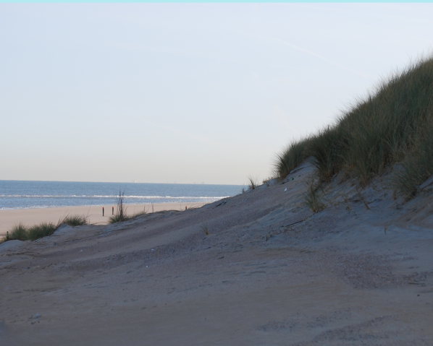
The second component - Land Extensions of the protection afforded by the Seawall
Houston Ship Channel
High
Island
Bolivar Peninsula
Bolivar Roads
Galveston Island
Existing Seawall
Intracoastal Waterway
• San Luis Pass
Notes:
The critical need is to stop the surge at the coast – this protects the entire Bay area
1. Protects from catastrophic overflows and
2. Doesn’t allow the ocean surge into the Bay which in turn prevents massive internal surges

Slide 16
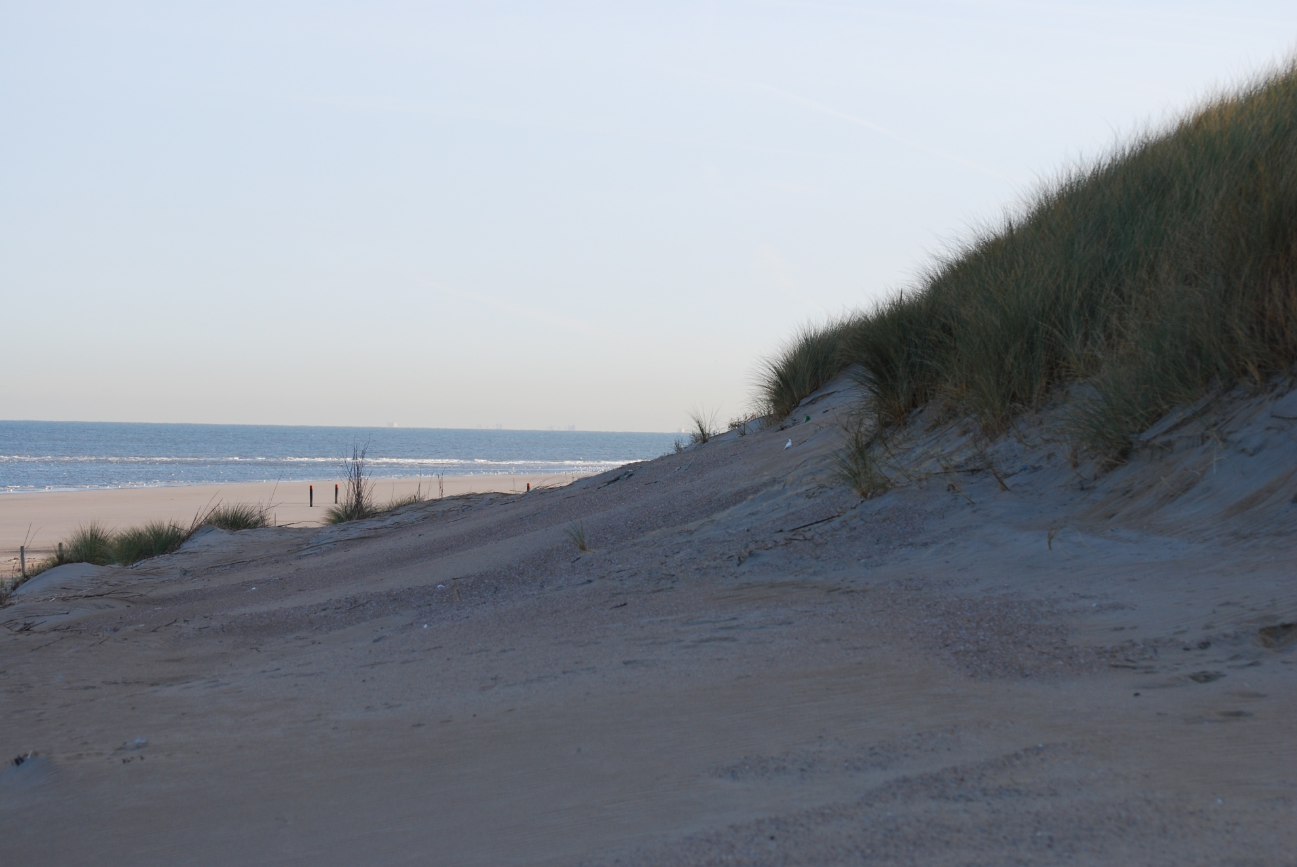
Revetments can be hidden to look natural

Slide 17
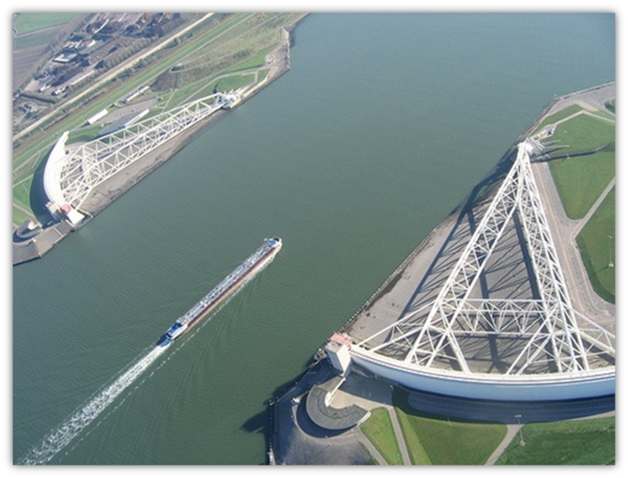
The third component – Flood Gates
Houston Ship Channel
High
Island
Bolivar Peninsula
Bolivar Roads
Galveston Island
Existing Seawall
Intracoastal Waterway
San Luis Pass
Notes:
San Luis Pass has only small boat traffic so gate design straightforward
Bolivar Roads needs a more comprehensive solution

Slide 18
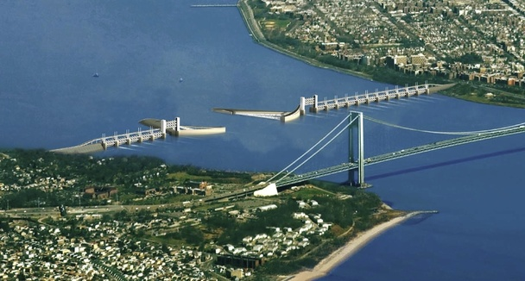
New York
ARCADIS

Slide 19
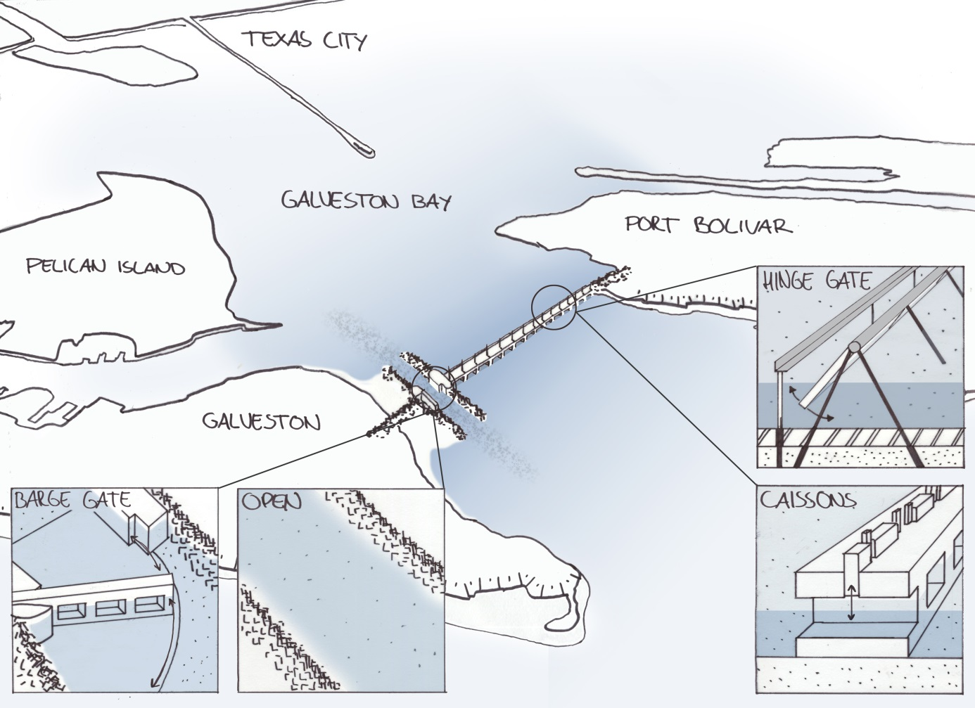

Slide 20
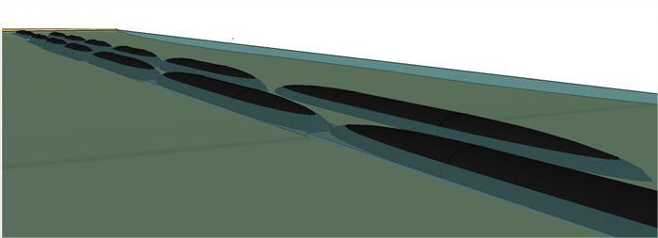

Another option:
Two rows of several bellows-dams
This option will decrease the water leakage.

Slide 21
Dutch Deltaworks and the Ike Dike
Shorten the coast as much as possible
Keep the surge out of internal waters
Use surge gates to accomplish the above
And to allow for ship traffic
And to preserve marine ecosystem function

Slide 22
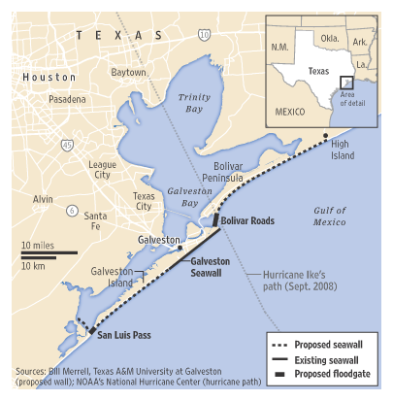
Ike Dike Characteristics
System can be leaky - unlike New Orleans, Holland
Can use Galveston Bay as a retention pond
Stops the Surge at the coast where it’s the smallest
Only needs to hold maximum surge for a few hours
Doesn’t harm neighboring communities
Doesn’t lead to a race for more and higher dikes
●●●●●
Proposed revetment
Notes:
Hurricane surge barriers can employ much different designs than river levees which must work of days or even weeks or flood barriers that protect areas below sea level. If the Ike dike leaks the water will just run into Galveston Bay which would act like a very large holding pond.

Slide 23
The Ike Dike - Economics
Protects People, Properties and Industrial Base for a Nationally Important Region
National Center – Jet Fuels, Gasoline, Special Military Fuels, Chemical Feedstock
Will Encourage Economic Development through Investment in and Commitment to the Region
Significant Flood Insurance Rate Reductions
Whole Region Recovers Quickly
Costs Less than a Single Major Hurricane Recovery
Costs Less than Armoring the Entire Bay Complex
Costs Much Less than the New Orleans Barrier

Slide 24
The Ike Dike - Environment
Occupies Minimum Footprint for Comprehensive Protection
Bay’s Shores Not Affected
More Environmentally Sound than Armoring the Entire Bay Complex
Prevents Surge Damage to the Bay’s Natural Resources
Does NOT reduce fresh water flows into Galveston Bay
Builds on the Dutch experience of a quarter century of successful Bay ecosystem function behind the Eastern Scheldt barrier

Slide 25
The Ike Dike - People
Protects Lives – Especially from Hurricanes that Quickly Change Path or Intensity
Allows for Smaller, More Orderly Evacuations
Protects All Residents and Communities, Rich or Poor, in the Region
Best (and Perhaps Only) Way to Protect Our Less Resilient Populations
Whole Region Recovers Quickly

Slide 26
A Coastal Spine Suppresses Surge and is
Technically Feasible
Economically Sound
Environmentally Friendly, and
Socially Just
It Should Be the Cornerstone of Our Surge Suppression Strategy

Slide 27
Ike Dike Research Approach/Sequence
Economic Study With Special Emphasis on Petrochemical Industry
Modeling to Inform the Economic Study and Barrier Design
And to Understand Better Galveston Bay’s Roles
Test Barrier Conceptual Designs
Including Landscape Integration
Generate Better Cost Estimates
Calculate Cost/Benefit Ratios

Slide 28
Research Team
Economics
  Dr Bill Gilmer, Institute for Regional Forecasting, University of Houston
  Drs Wes Highfield and Meri Davlasheridze, TAMUG
Surge Modeling
  Dr Robert Whalin, Homeland Security Center of Excellence , Jackson State University
  Dr Jeff Melby, USACE/Engineering Research & Development Center
Barrier Design
  Dr Bas Jonkman, Delft Technical University
  Dr Jens Figlus, TAMUG
  Drs Galen Newman and Eric Bardenhagen, Landscape Architecture, TAMU
Overall Flood Risk Reduction/Project Coordination
  Dr Sam Brody, COL Len Waterworth and Dr Bill Merrell, TAMUG

Slide 29
Ike Dike Ongoing Activities
Fundraising for Research and Outreach
Research Necessary for Cost/Benefits
Strategic Partnership with Bay Area Houston Economic Partnership (BAHEP)
BAHEP Forming/Leading Communications and Advocacy Efforts
Bay Area Coastal Protection Alliance Formed
TAMUG Outreach Leading to Understanding - Endorsements of Concept

Slide 30
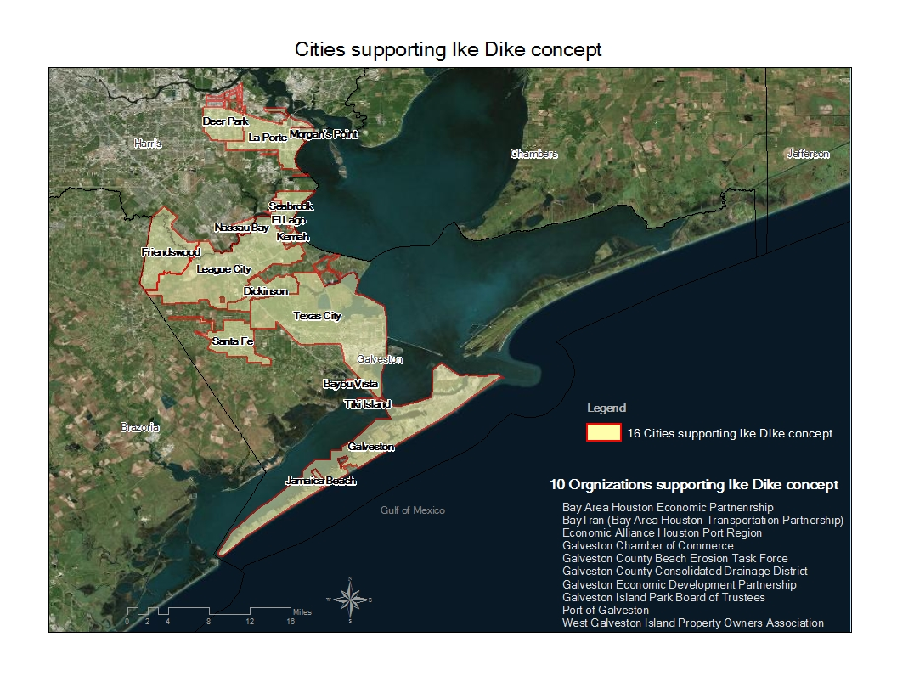

Slide 31

www.tamug.edu/ikedike

